Slide 1
General Purpose I/O

Slide 2
Overview
How do we make a program light up LEDs in response to a switch?
GPIO
Basic Concepts
Port Circuitry
Control Registers
Accessing Hardware Registers in C
Clocking and Muxing
Circuit Interfacing
Inputs
Outputs
Additional Port Configuration

Slide 3
Basic Concepts
Goal: light either LED1 or LED2 based on switch SW1 position
GPIO = General-purpose input and output (digital)
Input: program can determine if input signal is a 1 or a 0
Output: program can set output to 1 or 0
Can use this to interface with external devices
Input: switch
Output: LEDs

Slide 4
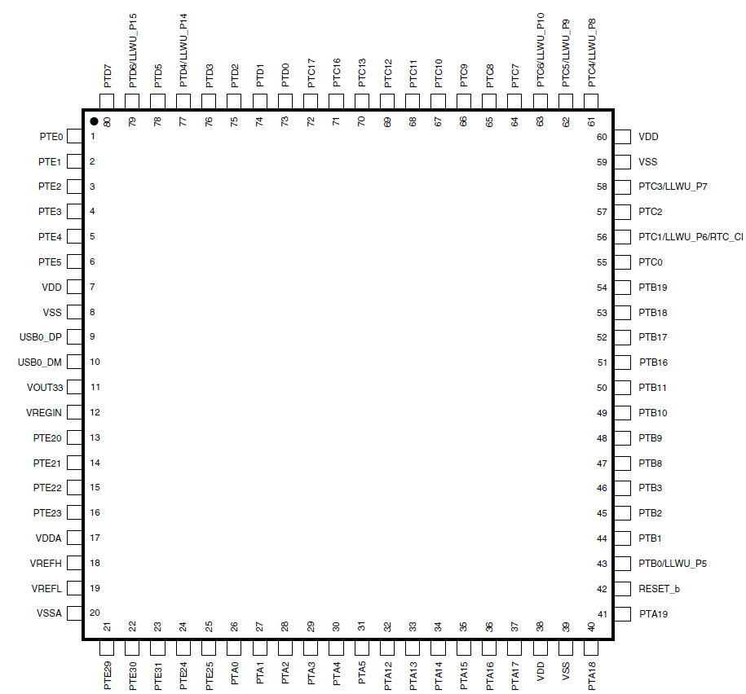
KL25Z GPIO Ports
Port A (PTA) through Port E (PTE)
Not all port bits are available
Quantity depends on package pin count

Slide 5
GPIO Port Bit Circuitry in MCU
Configuration
Direction
MUX
Data
Output (different ways to access it)
Input

Slide 6
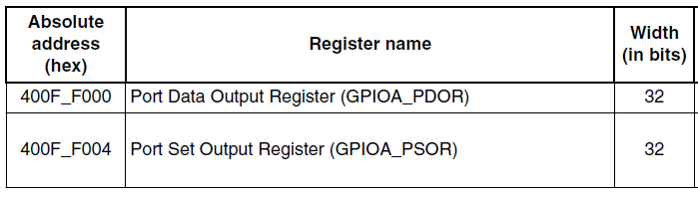
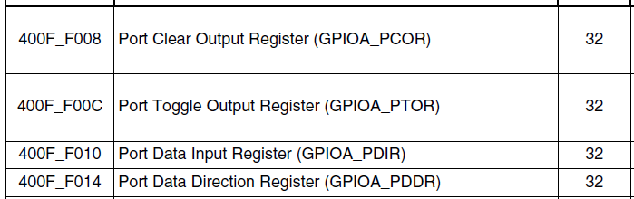
Control Registers
One set of control registers per port
Each bit in a control register corresponds to a port bit

Slide 7
PDDR: Port Data Direction
Each bit can be configured differently
Input: 0
Output: 1
Reset clears port bit direction to 0

Slide 8
Writing Output Port Data
Direct: write value to PDOR
Toggle: write 1 to PTOR
Clear (to 0): Write 1 to PCOR
Set (to 1): write 1 to PSOR

Slide 9
Reading Input Port Data
Read from PDIR

Slide 10
Pseudocode for Program
// Make PTA1 and PTA2 outputs
set bits 1 and 2 of GPIOA_PDDR
// Make PTA5 input
clear bit 5 of GPIOA_PDDR
// Initialize the output data values: LED 1 off, LED 2 on
clear bit 1, set bit 2 of GPIOA_PDOR
// read switch, light LED accordingly
do forever {
if bit 5 of GPIOA_PDIR is 1 {
// switch is not pressed, then light LED 2
set bit 2 of GPIOA_PDOR
clear bit 1 of GPIO_PDOR
} else {
// switch is pressed, so light LED 1
set bit 1 of GPIOA_PDOR
clear bit 2 of GPIO_PDOR
}
}

Slide 11
CMSIS - Accessing Hardware Registers in C
Header file MKL25Z4.h defines C data structure types to represent hardware registers in MCU with CMSIS-Core hardware abstraction layer
/** GPIO - Register Layout Typedef */
typedef struct {
__IO uint32_t PDOR; /**< Port Data Output Register, offset: 0x0 */
__O uint32_t PSOR; /**< Port Set Output Register, offset: 0x4 */
__O uint32_t PCOR; /**< Port Clear Output Register, offset: 0x8 */
__O uint32_t PTOR; /**< Port Toggle Output Register, offset: 0xC */
__I uint32_t PDIR; /**< Port Data Input Register, offset: 0x10 */
__IO uint32_t PDDR; /**< Port Data Direction Register, offset: 0x14 */
} GPIO_Type;

Slide 12
Accessing Hardware Registers in C (2)
Header file MKL25Z4.h declares pointers to the registers
/* GPIO - Peripheral instance base addresses */
/** Peripheral PTA base address */
#define PTA_BASE (0x400FF000u)
/** Peripheral PTA base pointer */
#define PTA ((GPIO_Type *)PTA_BASE)
PTA->PDOR = …

Slide 13
Coding Style and Bit Access
Easy to make mistakes dealing with literal binary and hexadecimal values
“To set bits 13 and 19, use 0000 0000 0000 1000 0010 0000 0000 0000 or 0x00082000”
Make the literal value from shifted bit positions
n = (1UL << 19) | (1UL << 13);
Define names for bit positions
#define GREEN_LED_POS (19)
#define YELLOW_LED_POS (13)
n = (1UL << GREEN_LED_POS) | (1UL << YELLOW_LED_POS);
Create macro to do shifting to create mask
#define MASK(x) (1UL << (x))
n = MASK(GREEN_LED_POS) | MASK(YELLOW_LED_POS);

Slide 14
Using Masks
Overwrite existing value in n with mask
n = MASK(foo);
Set in n all the bits which are one in mask, leaving others unchanged
n |= MASK(foo);
Complement the bit value of the mask
~MASK(foo);
Clear in n all the bits which are zero in mask, leaving others unchanged
n &= MASK(foo);

Slide 15
C Code
#define LED1_POS (1)
#define LED2_POS (2)
#define SW1_POS (5)
#define MASK(x) (1UL << (x))
PTA->PDDR |= MASK(LED1_POS) | MASK (LED2_POS); // set LED bits to outputs
PTA->PDDR &= ~MASK(SW1_POS); // clear Switch bit to input
PTA->PDOR = MASK(LED2_POS); // turn on LED1, turn off LED2
while (1) {
if (PTA->PDIR & MASK(SW1_POS)) {
// switch is not pressed, then light LED 2
PTA->PDOR = MASK(LED2_POS);
} else {
// switch is pressed, so light LED 1
PTA->PDOR = MASK(LED1_POS);
}
}

Slide 16
Clocking Logic
Bit | Port
13 | PORTE
12 | PORTD
11 | PORTC
10 | PORTB
9 | PORTA
Need to enable clock to GPIO module
By default, GPIO modules are disabled to save power
Writing to an unclocked module triggers a hardware fault!
Control register SIM_SCGC5 gates clocks to GPIO ports
Enable clock to Port A
SIM->SCGC5 |= (1UL << 9);
Header file MKL25Z4.h has definitions
SIM->SCGC5 |= SIM_SCGC5_PORTA_MASK;

Slide 17
Connecting a GPIO Signal to a Pin
Multiplexer used to increase configurability - what should pin be connected with internally?
Each configurable pin has a Pin Control Register

Slide 18
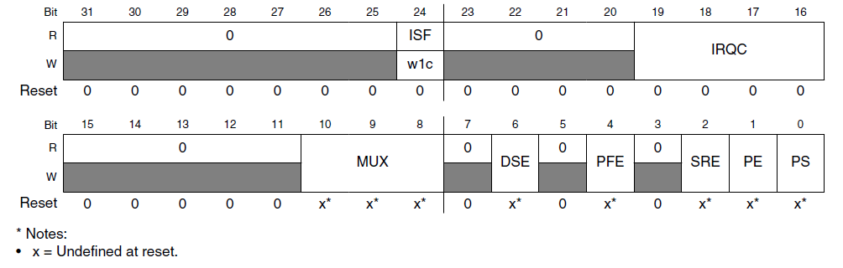
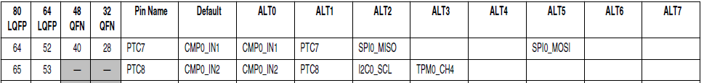
Pin Control Register
MUX (bits 10-8) | Configuration
000 | Pin disabled (analog)
001 | Alternative 1 – GPIO
010 | Alternative 2
011 | Alternative 3
100 | Alternative 4
101 | Alternative 5
110 | Alternative 6
111 | Alternative 7
MUX field of PCR defines connections

Slide 19
CMSIS C Support for PCR
MKL25Z4.h defines PORT_Type structure with a PCR field (array of 32 integers)
/** PORT - Register Layout Typedef */
typedef struct {
__IO uint32_t PCR[32]; /** Pin Control Register n, array offset: 0x0, array step: 0x4 */
__O uint32_t GPCLR; /** Global Pin Control Low Register, offset: 0x80 */
__O uint32_t GPCHR; /** Global Pin Control High Register, offset: 0x84 */
uint8_t RESERVED_0[24];
__IO uint32_t ISFR; /** Interrupt Status Flag Register, offset: 0xA0 */
} PORT_Type;

Slide 20
CMSIS C Support for PCR
Header file defines pointers to PORT_Type registers
/* PORT - Peripheral instance base addresses */
/** Peripheral PORTA base address */
#define PORTA_BASE (0x40049000u)
/** Peripheral PORTA base pointer */
#define PORTA ((PORT_Type *)PORTA_BASE)
Also defines macros and constants
#define PORT_PCR_MUX_MASK 0x700u
#define PORT_PCR_MUX_SHIFT 8
#define PORT_PCR_MUX(x) (((uint32_t)(((uint32_t)(x))<<PORT_PCR_MUX_SHIFT)) &PORT_PCR_MUX_MASK)

Slide 21
Resulting C Code for Clock Control and Mux
// Enable Clock to Port A
SIM->SCGC5 |= SIM_SCGC5_PORTA_MASK;
// Make 3 pins GPIO
PORTA->PCR[LED1_POS] &= ~PORT_PCR_MUX_MASK;
PORTA->PCR[LED1_POS] |= PORT_PCR_MUX(1);
PORTA->PCR[LED2_POS] &= ~PORT_PCR_MUX_MASK;
PORTA->PCR[LED2_POS] |= PORT_PCR_MUX(1);
PORTA->PCR[SW1_POS] &= ~PORT_PCR_MUX_MASK;
PORTA->PCR[SW1_POS] |= PORT_PCR_MUX(1);
Notes:
PORTA->PCR[LED1_POS] &= ~PORT_PCR_MUX_MASK; // put 000 for the 3 bits mux selection
PORTA->PCR[LED1_POS] |= PORT_PCR_MUX(1); // sets the mux selection to 1 (the GPIO)
System Clock Gating Control Register 5 is described on page 206 of KL25P80M48SF0RM DataSheet

Slide 22
Interfacing
Inputs and Outputs, Ones and Zeros, Voltages and Currents

Slide 23
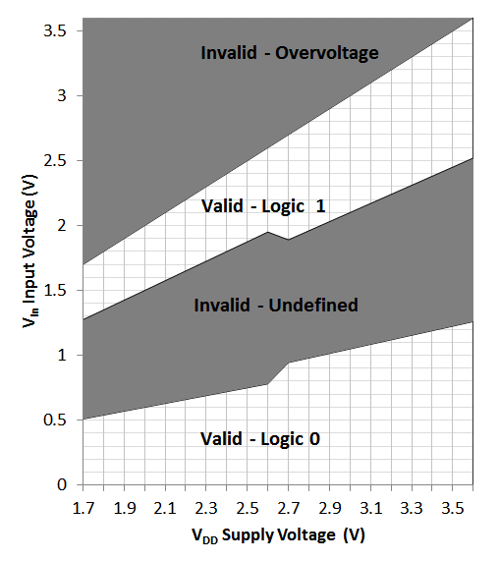
Inputs: What’s a One? A Zero?
Input signal’s value is determined by voltage
Input threshold voltages depend on supply voltage V_{DD}
Exceeding V_{DD} or GND may damage chip

Slide 24
Outputs: What’s a One? A Zero?
Nominal output voltages
1: V_{DD}-0.5 V to V_{DD}
0: 0 to 0.5 V
Note: Output voltage depends on current drawn by load on pin
Need to consider source-to-drain resistance in the transistor
Above values only specified when current < 5 mA (18 mA for high-drive pads) and V_{DD} > 2.7 V
Logic 1 out
V_{out}
Logic 0 out
I_{out}

Slide 25
Output Example: Driving LEDs
Need to limit current to a value which is safe for both LED and MCU port driver
Use current-limiting resistor
R = (V_{DD} – V_{LED})/I_{LED}
Set I_{LED} = 4 mA
V_{LED} depends on type of LED (mainly color)
Red: ~1.8V
Blue: ~2.7 V
Solve for R given VDD = ~3.0 V
Red: 300 Ω
Blue: 75 Ω
Demonstration code in Basic Light Switching Example

Slide 26
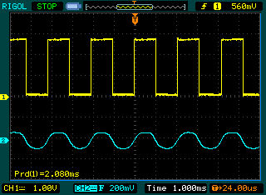
Output Example: Driving a Speaker
Create a square wave with a GPIO output
Use capacitor to block DC value
Use resistor to reduce volume if needed
Write to port toggle output register (PTOR) to simplify code
void Beep(void) {
unsigned int period=20000;
while (1) {
PTC->PTOR = MASK(SPKR_POS);
Delay(period/2);
}
}

Slide 27
Additional Configuration in PCR
Pull-up and pull-down resistors
Used to ensure input signal voltage is pulled to correct value when high-impedance
PE: Pull Enable. 1 enables the pull resistor
PS: Pull Select. 1 pulls up, 0 pulls down.
High current drive strength
DSE: Set to 1 to drive more current (e.g. 18 mA vs. 5 mA @ > 2.7 V, or 6 mA vs. 1.5 mA @ <2.7 V)
Available on some pins - MCU dependent

